Slide 1
Response Rates and Errors
MKTG 302-01
Spring Semester, 2025
Scott Beck

Slide 2
Student Learning Objectives
Learn about the different types of errors that occur when collecting primary data.
Learn ways to reduce errors when possible.

Slide 3
But first … some important dates ahead
Apr 10 – likely conclude survey ☺
Apr 15 – 1st draft, lecture on reporting and measurement
Apr 17 – Easter Break – no classes
Apr 22 – Work on Project in class
Apr 24 – Quiz #3
Apr 29 – 2nd draft (new date!)
Discussion with Burke, Inc. is cancelled!
Apr 30 – GABP Cincinnati Reds game and tour
May 1 – Wrap up Project!
May 6 – Presentation to Cincinnati Reds

Slide 4
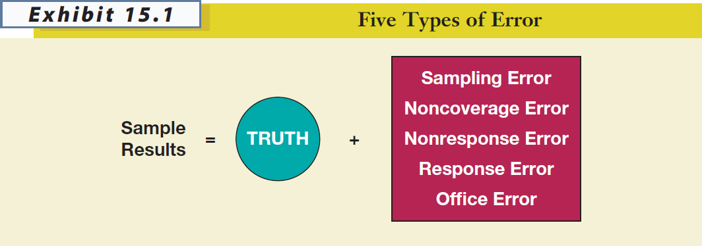

Slide 5
Sampling Error*
The difference between results obtained from a sample and results that would have been obtained had information been gathered from or about every member of the population.
Decreased by increasing sample size
Can be estimated (assuming probability sample)
Usually less troublesome than other kinds of error

Slide 6
HOWEVER, sampling error usually isn’t the biggest problem – it’s all the other things that contribute error to a project.
And these other sources of error can’t be accounted for statistically…

Slide 7
NONCOVERAGE ERROR *
Error that arises because of failure to include qualified elements of the defined population in the sampling frame.
- noncoverage error is essentially a sampling frame problem

Slide 8
Non-response error *
Error from failing to obtain information from some elements of the population that were selected and designated for the sample.
This is a potential problem that only occurs when those who respond are systematically different in some important way from those who don’t respond

Slide 9

Suppose that a university wanted to assess the success of its graduates, based on their annual salaries, five years after graduation.
Which graduates are more likely to return a survey?
Which graduates are less likely to return a survey?

Slide 10
The Primary Sources of Nonresponse Error *
Refusals
Not-at-Homes
It is better to work hard at generating responses from a smaller sampling pool than to start with a much larger sampling pool and ignore potential nonresponse error, even if the resulting sample size is smaller.
Pay attention to the response rates delivered by different online panel companies. The completion rate is not the same thing as the overall response rate!

Slide 11
Three Methods for Diagnosing Nonresponse Error *
(1) Contact a sample of nonrespondents
(2) Compare respondent demographics against known demographics of population
(3) Conduct an analysis of late responders vs. early responders

Slide 12
RESPONSE ERROR *
Error that occurs when an individual provides an inaccurate response, consciously or subconsciously, to a survey item.

Slide 13
Key Considerations with Response Error *
Does the respondent understand the question?
Does the respondent know the answer to the question?
Is the respondent willing to provide the true answer to the question?
Is the wording of the question or the situation in which it is asked likely to bias the response?
Source: Weiers (1988)

Slide 14
Office Error *
OFFICE ERROR
Error due to data editing, coding, or analysis errors.
Design your survey in such a way to help you minimize office error:
Label all items
Be consistent with numbering (reverse coding)
Minimize use of open ended questions
ALWAYS save an unedited version of your data

Slide 15
Total Error is the Key *
The goal is to decrease overall error, not any one source of error.
Sampling Error
Non-coverage Error
Non-response Error
Response Error
Office Error

Slide 16
Calculating response rate
RESPONSE RATE *
The number of completed interviews with responding units divided by the number of eligible responding units in the sample.

Slide 17
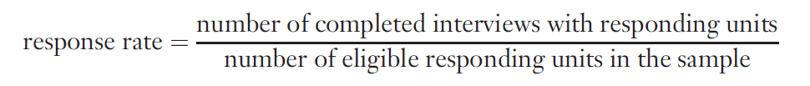
General formula *

Slide 18
Online and Mail surveys *

Slide 19
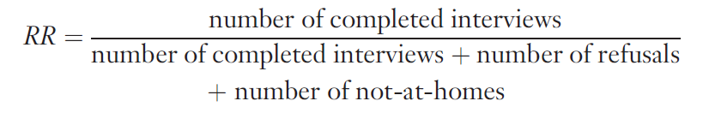
Telephone surveys *

Slide 20

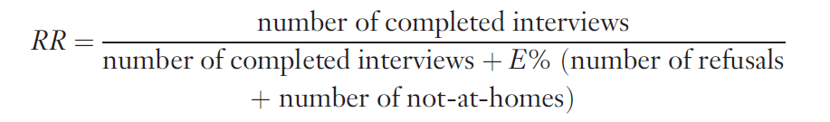
Mail Surveys, Online Surveys, and Telephone Interviews (With Eligibility Requirement)

Slide 21
Example
You’ve conducted an online survey, attempting to contact 500 people; the 500 sample elements have been classified as follows:
completed surveys: 250
refusals: 200
ineligibles: 50
What was your response rate?

Slide 22
250
E % = ---------------- = 83%
250 + 50
250
RR = ---------------------------------- = 60%
250 + [.83] [200]

Slide 23
Improving Response Rates *
The response rate on a project serves as an indicator of the overall quality of a data collection effort. It also provides insight into the likely influence of nonresponse error on the project.
Researchers must strive to obtain the highest response rates possible in a given situation.

Slide 24
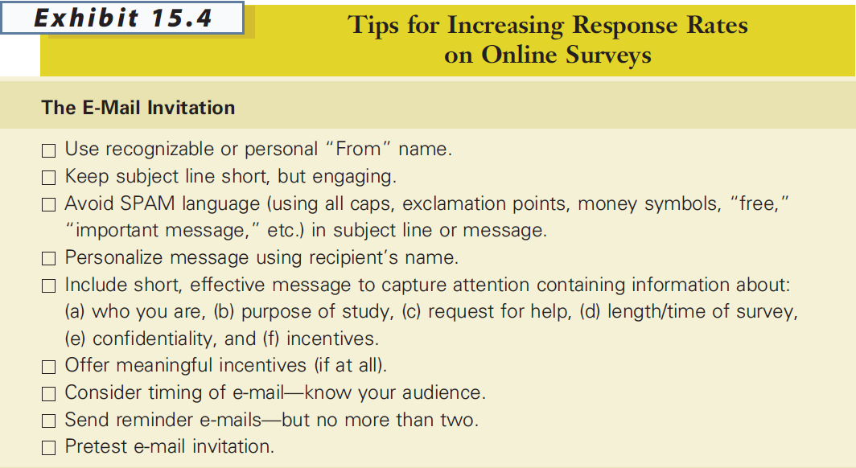
Improving Response Rates *

Slide 25
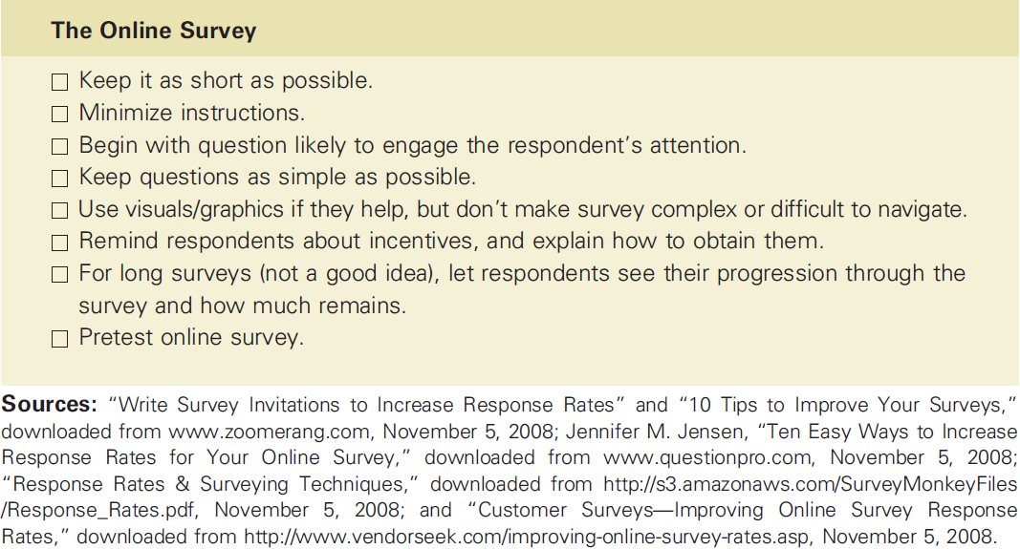
Improving Response Rates

Slide 26
Improving Response Rates
Respondent interest in topic
Survey length
Guarantee of confidentiality or anonymity
Interviewer characteristics and training
Personalization
Response incentives
Follow-up surveys

Slide 27


